Slide 1
Designing Infinite Cube
Name
Institution
Date

Slide 2
Infinite cubes
Infinite cubes is an idea of printing small toys that anyone can play with to have fun
They are simple and easy to use with no attached electricity
Good for releasing stress

Slide 3
How to make
Process for making the cubes
Prepare 8 cubes each with a hole in two sides
Hold the cubes together by inserting a stick or a plastic through the holes
Make sure that the stick or the plastic has a ranch at both ends
The ranch helps in holding the stick in its place

Slide 4
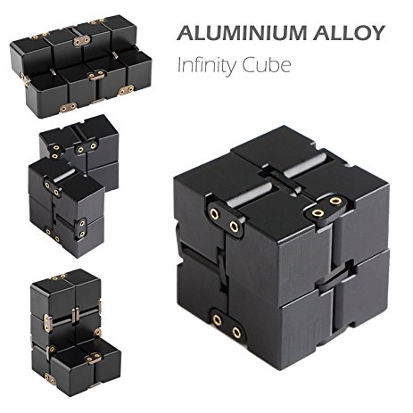
Picture of the cubes

Slide 5
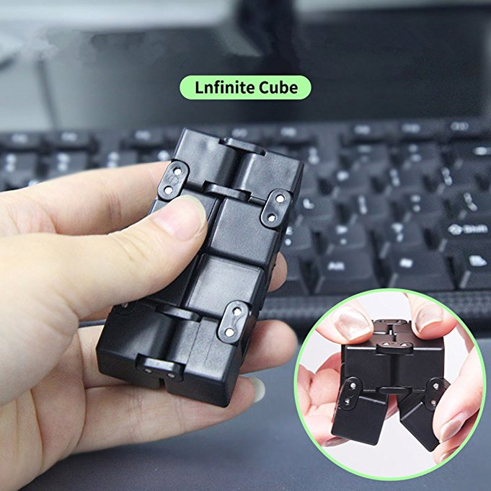
Cont’

Slide 6
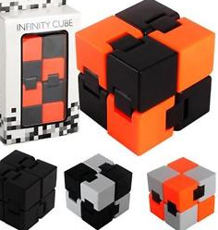

Slide 7
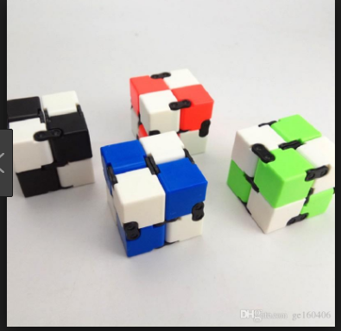

Slide 8
How to use
The cube has 8 smaller individual cubes
Each has 6 faces, with 48 small faces
24 four small faces are seen upon folding the cubes
At the same time 24 faces will be hidden when the cube is folded
Also three rectangles are seen consisting of 8 small faces every time of folding

Slide 9
Preferred Group of user
Infinite cube helps the following group:
People trying to quit smoking
Nail biting
Leg shaking
Students and office workers who want to free stress

Slide 10
Benefits to office users
fidgeting with infinity cube improves focus
enhances concentration on the task at hand
functions as the perfect office accessory that enable a person to fidget with one hand while working with the other
enhances the brainstorming of ideas

Slide 11
Challenges Faced in Designing the Infinite Cube
The following were challenges encountered:
designing the cube into the right shape took longer than expected
challenges of designing the best quality to be printed by the 3D printer
collection of the material especially uniform cubes was challenging

Slide 12
Programs for Designing The Infinite Cube
The following programs were used in designing:
Solidwork
MasterCam
Cora :to slice to object to make it ready to be printed by the printer

Slide 13
Specifications
The following specifications were used
Material:
1.75 mm PLA filament Peak Green-1KG (N.W.)
Print Temperature: 205-225 C
Whole dimensions: 1.57*1.57* inch (4*4*4cm)
Net Weight: 38.3 g
Gross Weight: 54g
Color: Orange

Slide 14
Cont’
The offset between all the faces: 0.25 mm
the space allows free movement of the cubes during folding
during folding the change in faces after the third time should have FALL 2017
The 4 cubes right below FALL 2017 should have class name ENGR 4081

Slide 15
CONT’
The following time was needed to print
4 hours since each cube required 30 minutes
Cost
Filament Cost: each = 2m *4 = 8m
1 kilp= $ 20
Cost for 100 gram *8= 800

Slide 16
Conclusion
Conclusively, infinity cube game plays an important role in opening up the minds of the following people:
designers
players involved in folding
people Watching the players

Slide 17
Reference
How to make an easy INFINIT CUBE!
Youtube
https://m.youtube.com

